Slide 1

MALIGNANT COMMENT CLASSIFIER
SUBMITTED BY – AMAN KUMAR PATEL
Batch – internship 25
Sme – md. kashif

Slide 2
Introduction
As we know People are using social media as a platform to express their opinions and views.
However, at the same time, this has resulted in the emergence of conflict and hate, making online environments uninviting for users.
Online hate, described as abusive language, aggression, cyberbullying, hatefulness and many others has been identified as a major threat on online social media platforms.
Our goal is to build a prototype of online hate and abuse comment classifier which can used to classify hate and offensive comments so that it can be controlled and restricted from spreading hatred and cyberbullying.

Slide 3
Multi labeled classification:
This is a multi-label classification problem, where the data can belong to more than one label. Thus, in this dataset the comment can be of one or more categories.
The goal of the multi-label classification is to determine whether or not a comment is toxic or non-toxic. If toxic, to determine what kind of toxicity the comment is, like-in, malignant, highly-malignant, threat, rude, abuse or loathe. Thus, a model needs to be created in order to differentiate between comments and its categories.

Slide 4
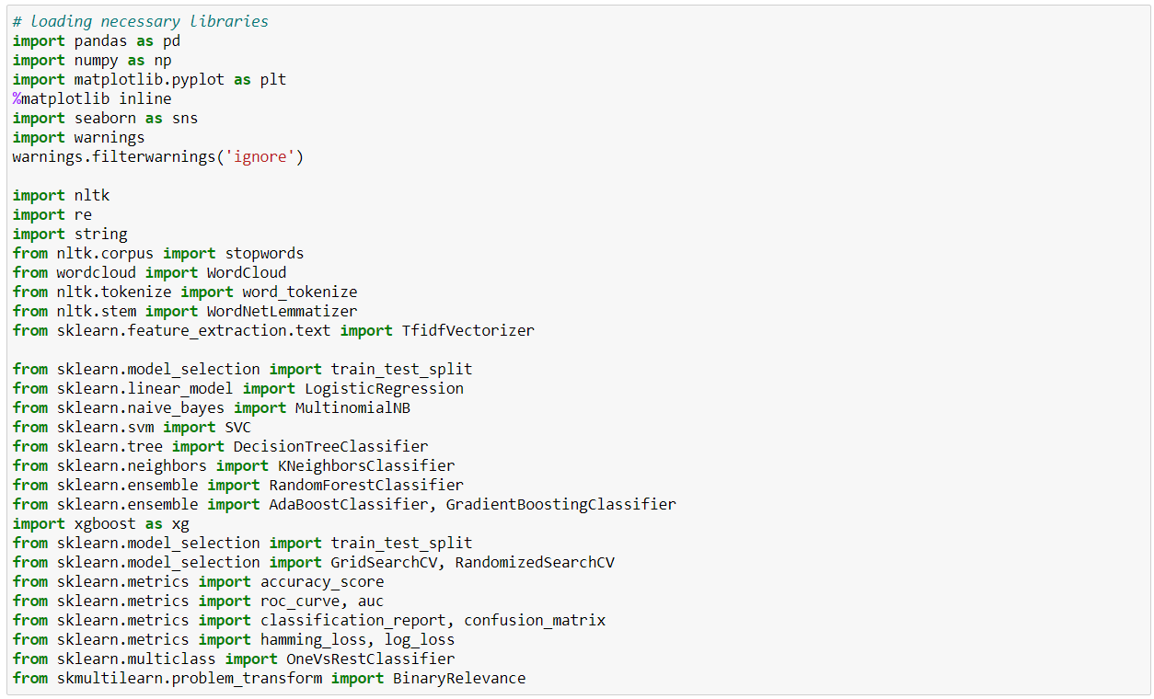
Libraries we have imported

Slide 5
The Dataset
Malignant: It is the Label column, which includes values 0 and 1, denoting if the comment is malignant or not.
Highly Malignant: It denotes comments that are highly malignant and hurtful.
Rude: It denotes comments that are very rude and offensive.
Threat: It contains indication of the comments that are giving any threat to someone.
Abuse: It is for comments that are abusive in nature.
Loathe: It describes the comments which are hateful and loathing in nature.
ID: It includes unique Ids associated with each comment text given.
Comment text: This column contains the comments extracted from various social media platforms.
The data set contains the training set, which has approximately 1, 59,000 samples and the test set which contains nearly 1, 53,000 samples.
All the data samples contain 8 fields.

Slide 6
Data Pre-Processing
We have Dropped the the column “ID” because of unique values, this will never help me to make model
Checking for null values, there were not any null values
Handled the missing values
Creating new feature
Clean the data
Statical summary

Slide 7
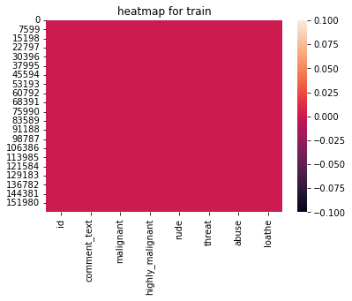
Null Values
Firstly we checked the null values with the train.isnull().sum(). And we get, there is not any null values in the both dataset train and test ,
So we decided to take a visualization of the null values with the heatmap

Slide 8
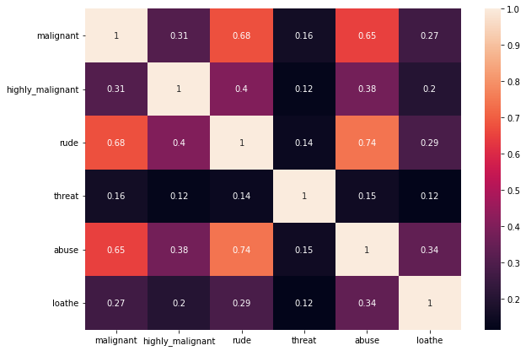
Correlation
The correlation of the numerical data determines the relationship and statistics more distinctly among the variables. It is obtained using corr() and is visualized using heatmap.

Slide 9
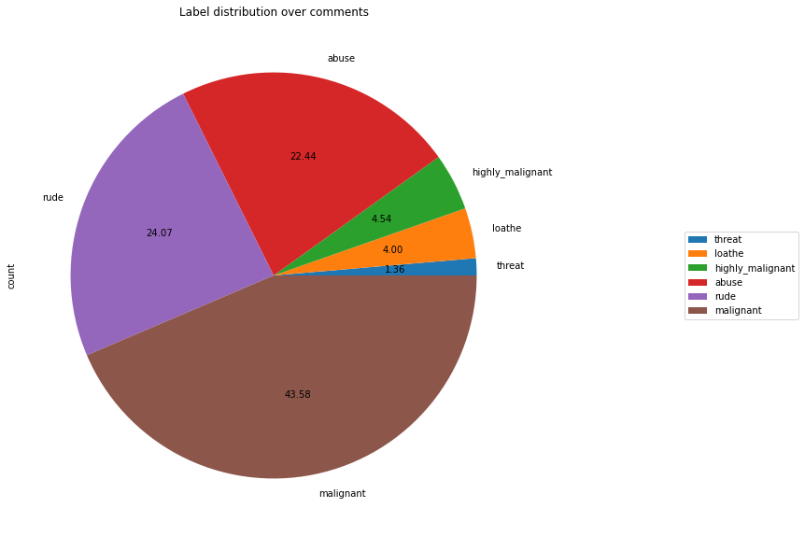
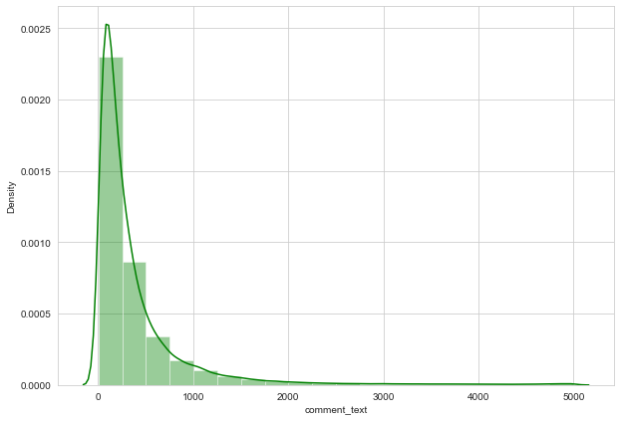
Data analyzation Distinctly through Visualization

Slide 10
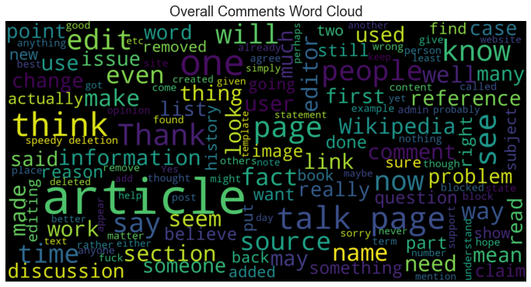
Data analyzation Distinctly through Visualization

Slide 11
Cleaning the Data
Replaced the extra lines or ‘\n’ from the text.
Transform the text into lower case.
Replaced the email addresses with the text 'emailaddress'
Replaced the URLs with the text 'webaddress’
Removed the HTML tags
Removed the punctuations
Removed all the non-ascii characters
Removed the unwanted white spaces
Removed the remaining tokens that are not alphabetic
Removed the stop words
Tokenized the text into words
Lemmatized the words

Slide 12
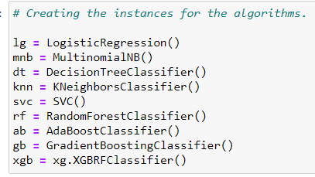
Algorithms
The data is vectorized using TF-IDF vectorizer.
‘X’ for train data and ‘test_X’ for test data was fitted into it and converted into an array with 10,000 maximum features.

Slide 13
Testing of Identified Algorithms in different ways
Firstly, the algorithms are trained and tested label-wise, for which a function is defined, which results in all the metrics used in order to find the best model, for each label.
Next, the models were trained and tested on an overall basis in order to have an overall results of the algorithms used.
As it is a multi-label classification problem, the methods to solve such type of classification are also used. The methods used are:
Binary Relevance
OneVsRestClassifier

Slide 14
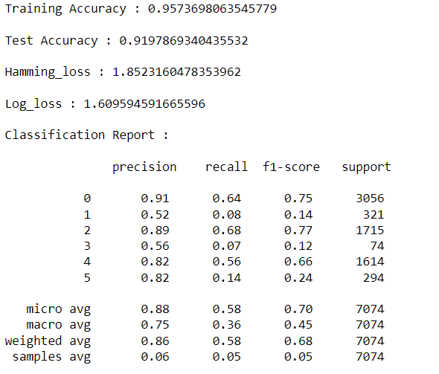
Results
SVC using oneVsRestClassifier is giving test accuracy of 95.73% and thus, selected as a best model for this data.

Slide 15
Hyper Tuning using GridSearchCV
Some selected models named:
Logistic Regression
SVC
Random Forest Classifier
are hypertuned on their respective parameters. And are evaluated on overall basis function and on multi-label classification methods.
The values are predicted of all the target variables or labels, with SVC using OneVsRestClassifier.
Then, converted the predicted values into a dataframe
The data has been saved in a csv file.

Slide 16
Conclusion
After analysing we can say In this project, several Classification models are built to predict the labels of the category of toxic comments.
This is a Machine Learning Approach combined with Natural Language Processing (NLP) for toxicity detection and its type identification in user comments.
The Mean Validation Accuracy, so obtained, is 90.08% which is by far the highest ever numeric accuracy reached by any Comment Toxicity Detection Model.
The research done in this project is intended to enhance fair online talk and views sharing in social media.

Slide 17

THANK
YOU

